Slide 1
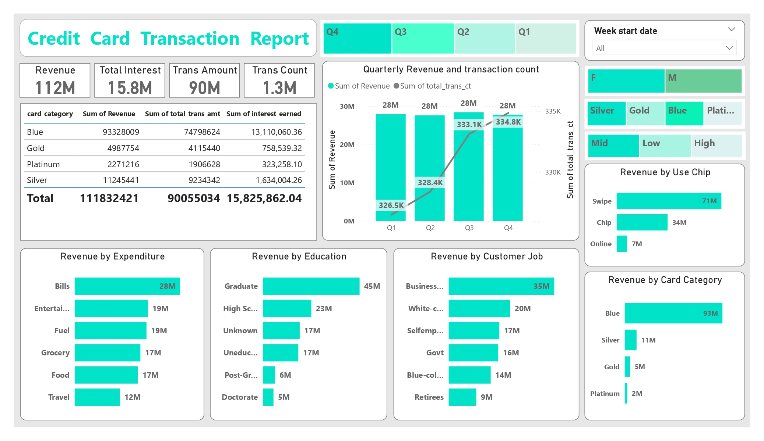

Slide 2
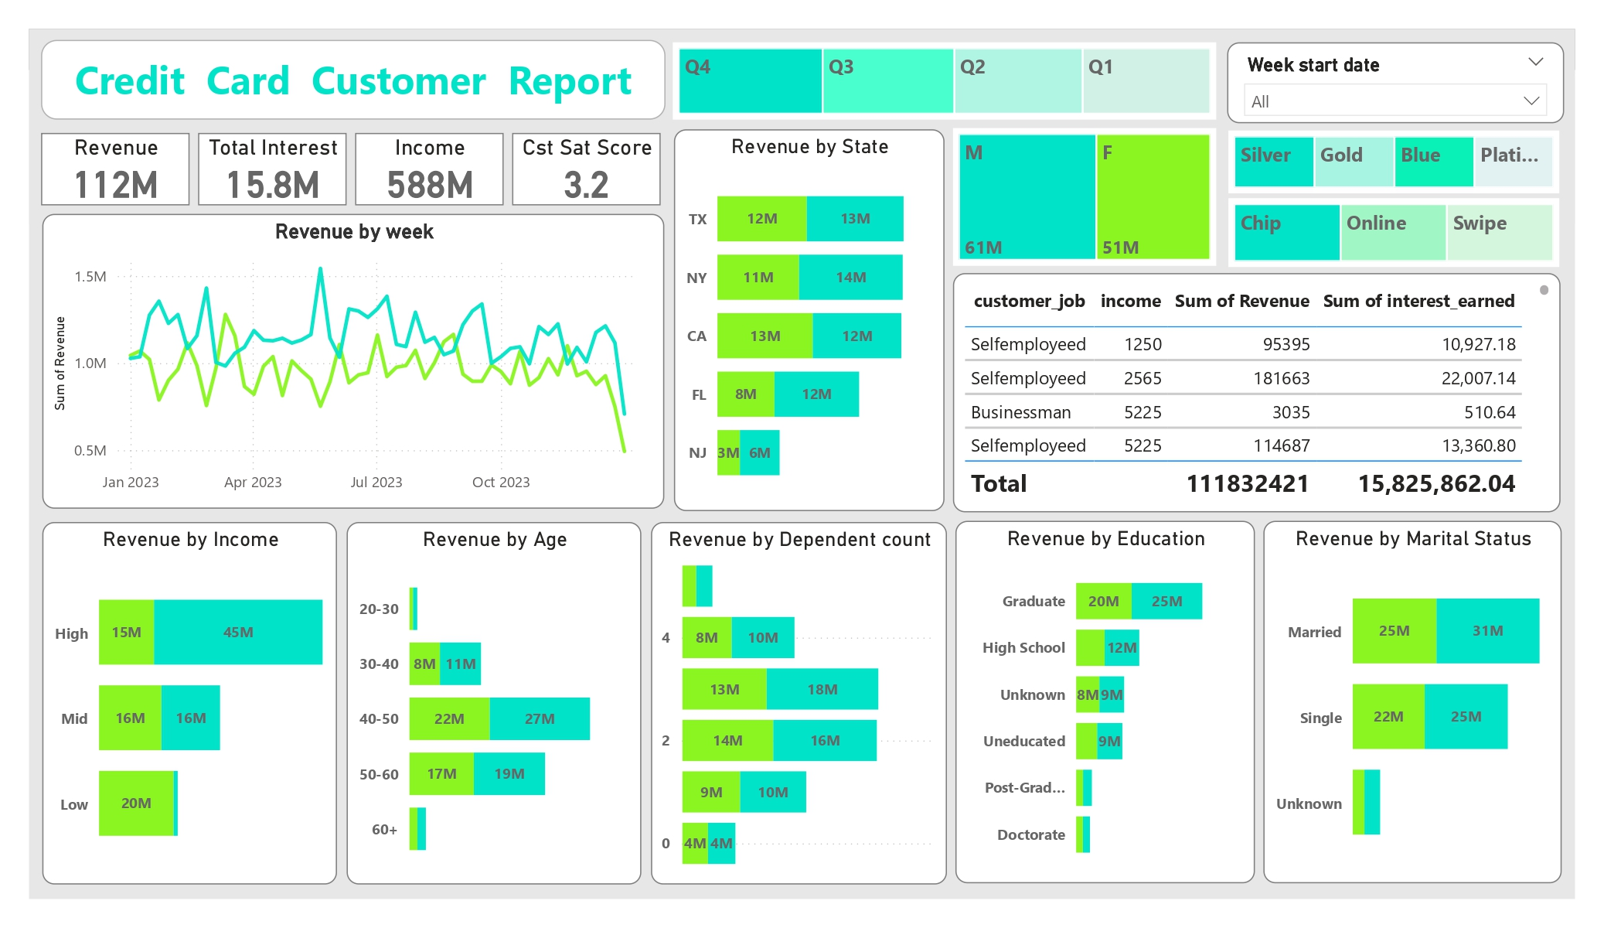

Slide 3
Week-on-Week Change:
The revenue generated from credit card transactions by customers has seen a slight increase compared to the previous week.
The percentage increase in the total transaction amount and transaction count remains consistent with the previous week's figures.
Year-to-Date (YTD) Overview:
Male users are the largest contributors to credit card revenue.
The majority of credit card users are between the ages of 40 and 50, with most having two dependents in their household.
Around 28 million users primarily use credit cards for bill payments and are involved in business activities.
The highest transaction interest is collected from 93 million blue category card users, while 2 million platinum card users contribute the least in this regard.
The monthly credit card activation rate among customers is strong.
The delinquency rate is comparatively low.

